Slide 1
Properties of
Context-Free languages

Slide 2
Positive Closure for CFL

Slide 3



Union
Context-free languages
are closed under:
Union
is context free
is context free
is context-free
Courtesy Costas Busch - RPI

Slide 4
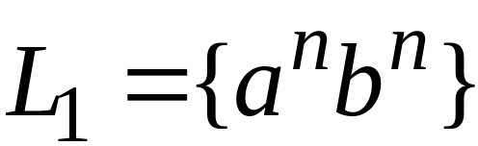
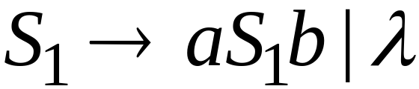
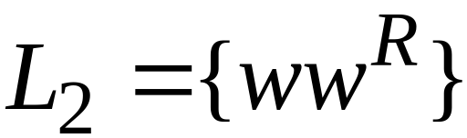
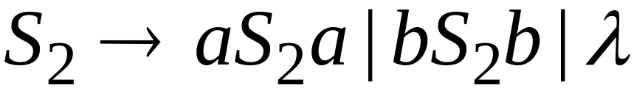
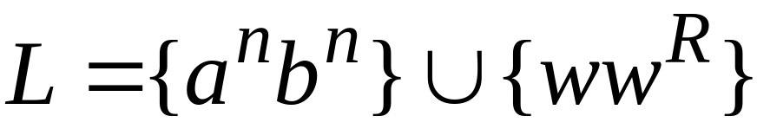

Example
Language
Grammar
Union
Courtesy Costas Busch - RPI

Slide 5
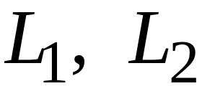
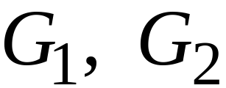
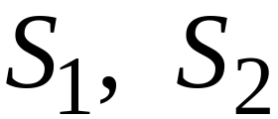

In general:
For context-free languages
with context-free grammars
and start variables
The grammar of the union
has new start variable
and additional production
Courtesy Costas Busch - RPI

Slide 6

Concatenation
Context-free languages
are closed under:
Concatenation
is context free
is context free
is context-free
Courtesy Costas Busch - RPI

Slide 7
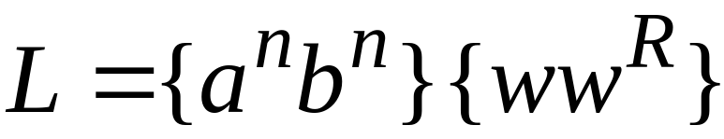
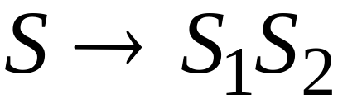
Example
Language
Grammar
Concatenation
Courtesy Costas Busch - RPI

Slide 8
In general:
For context-free languages
with context-free grammars
and start variables
The grammar of the concatenation
has new start variable
and additional production
Courtesy Costas Busch - RPI

Slide 9


Star Operation
Context-free languages
are closed under:
Star-operation
is context free
is context-free
Courtesy Costas Busch - RPI

Slide 10
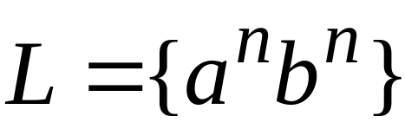
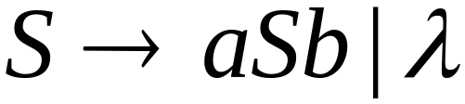
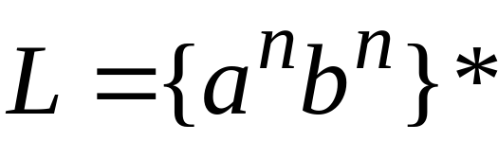
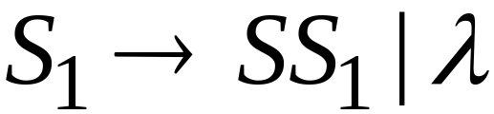
Example
Language
Grammar
Star Operation
Courtesy Costas Busch - RPI

Slide 11



In general:
For context-free language
with context-free grammar
and start variable
The grammar of the star operation
has new start variable
and additional production
Courtesy Costas Busch - RPI

Slide 12
Negative Closure for CFL
Courtesy Costas Busch - RPI

Slide 13

Intersection
Context-free languages
are not closed under:
intersection
is context free
is context free
not necessarily
context-free
Courtesy Costas Busch - RPI

Slide 14
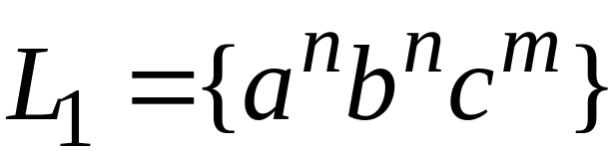
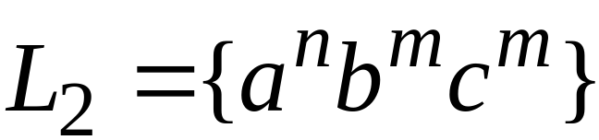
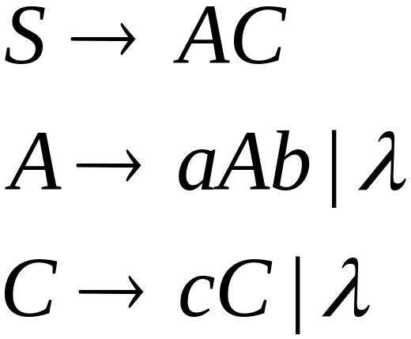
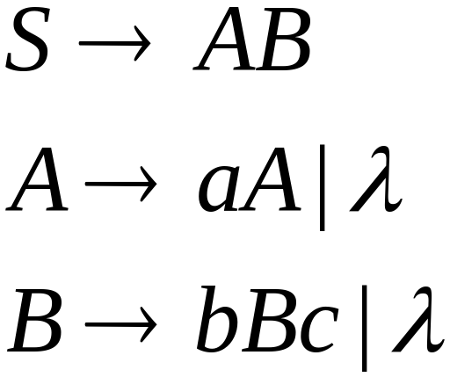
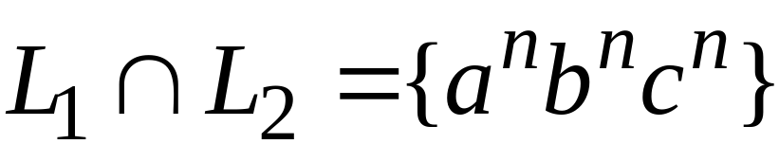
Example
Context-free:
Context-free:
Intersection
NOT context-free
Courtesy Costas Busch - RPI

Slide 15

Complement
Context-free languages
are not closed under:
complement
is context free
not necessarily
context-free
Courtesy Costas Busch - RPI

Slide 16
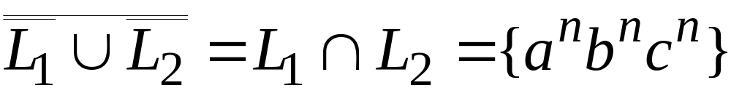
Example
Context-free:
Context-free:
Complement
NOT context-free
Courtesy Costas Busch - RPI

Slide 17
Intersection of
Context-free languages and
Regular Languages
Courtesy Costas Busch - RPI

Slide 18
The intersection of
a context-free language and
a regular language
is a context-free language
context free
regular
context-free
Courtesy Costas Busch - RPI

Slide 19



Machine
Machine
PDA
for
DFA
for
context-free
regular
Construct a new PDA machine
that accepts
simulates in parallel and
Courtesy Costas Busch - RPI

Slide 20
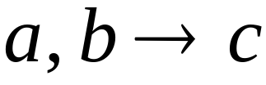




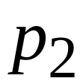
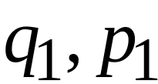
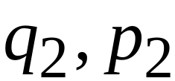
PDA
DFA
transition
transition
PDA
transition
Courtesy Costas Busch - RPI

Slide 21


PDA
DFA
transition
PDA
transition
Courtesy Costas Busch - RPI

Slide 22


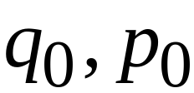
PDA
DFA
initial state
initial state
PDA
Initial state
Courtesy Costas Busch - RPI

Slide 23
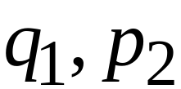
PDA
DFA
final state
final states
PDA
final states
Courtesy Costas Busch - RPI

Slide 24
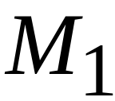









Example:
context-free
PDA
Courtesy Costas Busch - RPI

Slide 25
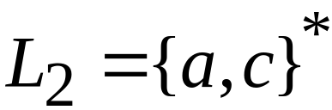
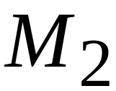


regular
DFA
Courtesy Costas Busch - RPI

Slide 26
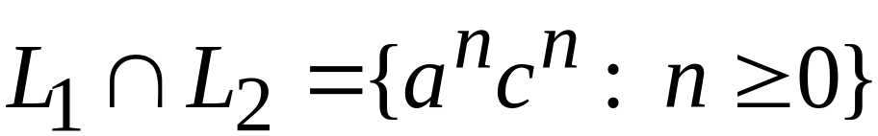





context-free
Automaton for:
PDA
Courtesy Costas Busch - RPI

Slide 27


In General:
simulates in parallel and
accepts string
if and only if
accepts string and
accepts string
Courtesy Costas Busch - RPI

Slide 28
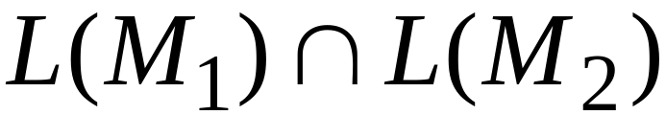
Therefore:
is PDA
is context-free
is context-free
Courtesy Costas Busch - RPI

Slide 29
Applications of
Regular Closure
Courtesy Costas Busch - RPI

Slide 30
The intersection of
a context-free language and
a regular language
is a context-free language
Regular Closure
context free
regular
context-free
Courtesy Costas Busch - RPI

Slide 31
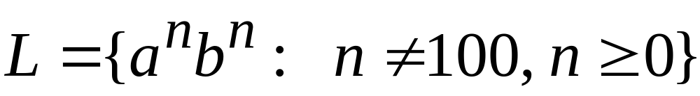
An Application of Regular Closure
Prove that:
is context-free
Courtesy Costas Busch - RPI

Slide 32

We know:
is context-free
Courtesy Costas Busch - RPI

Slide 33
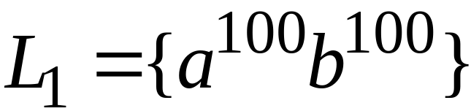
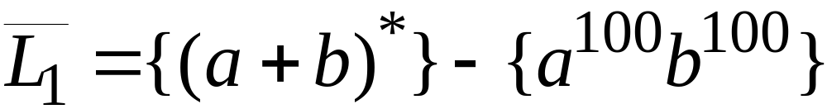
We also know:
is regular
is regular
Courtesy Costas Busch - RPI

Slide 34
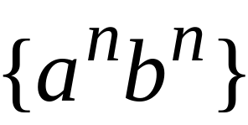
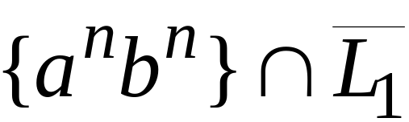
context-free
regular
(regular closure)
context-free
is context-free
Courtesy Costas Busch - RPI

Slide 35
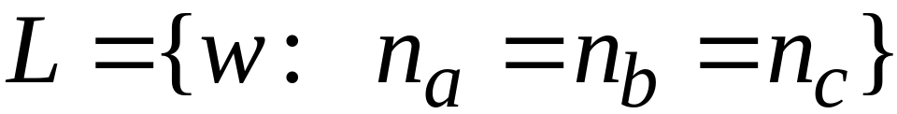
Another Application of Regular Closure
Prove that:
is not context-free
Courtesy Costas Busch - RPI

Slide 36
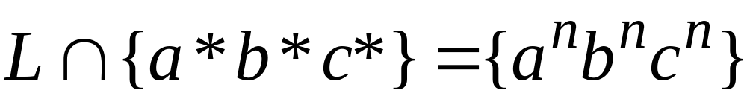
If
is context-free
(regular closure)
Then
context-free
regular
context-free
Impossible!!!
Therefore, is not context free
Courtesy Costas Busch - RPI

